Slide 1
The journey to magnetic monopoles
Idk what I’m doing pls send help

Slide 2
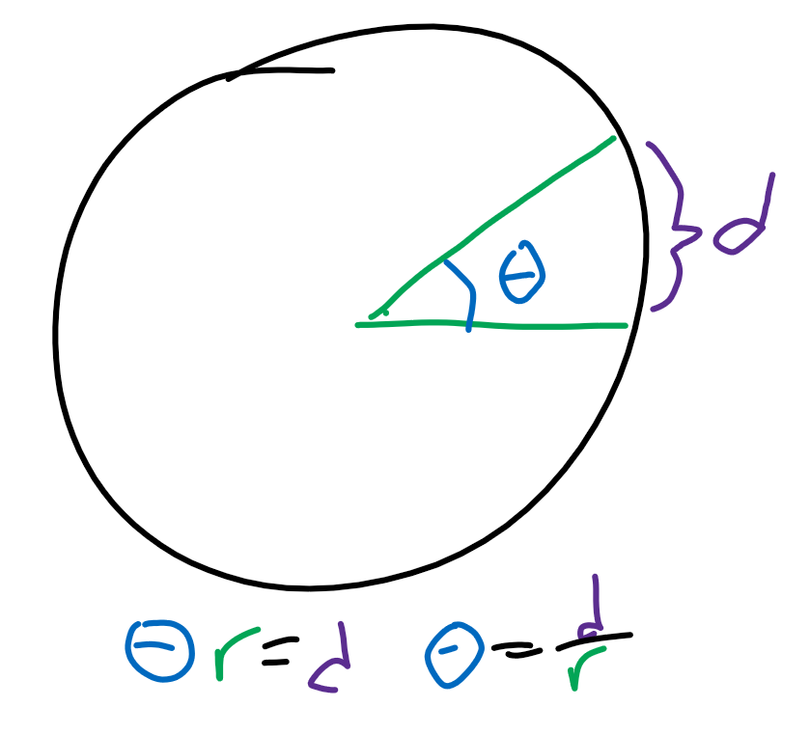
Angular quantities
The number of radians traveled in a circle is calculated by d/r where d is the distance traveled along the circle and r is radius.
This has units m/m, or 1.
Angular acceleration thus has units 1/s^2.

Slide 3
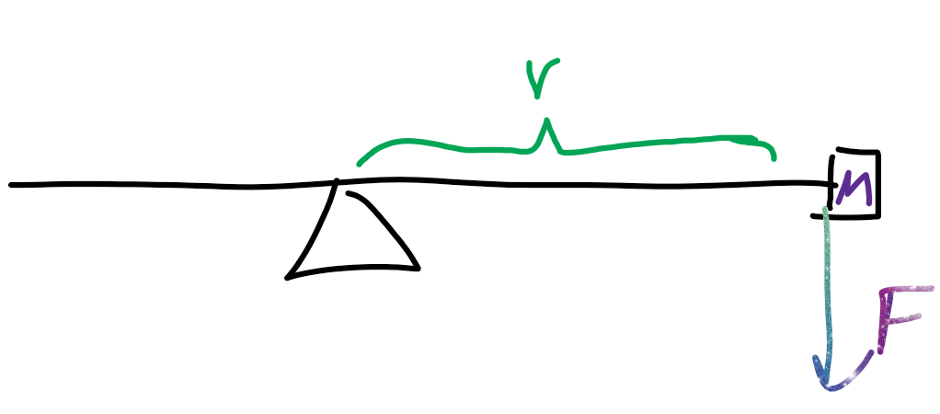
Torque
Torque is r x F, or the distance from the pivot crossed with the force.
The units here are mN.
Define “moment of inertia” I such that T = Ia where T is torque and a is angular acceleration.
I must have units kgm^2, so we can define I as mr^2.

Slide 4
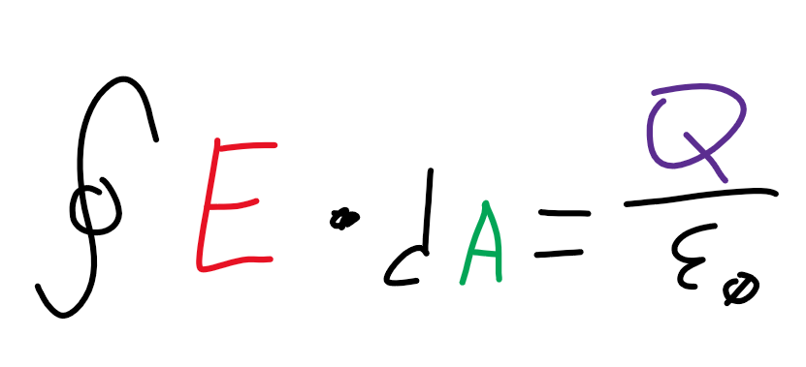
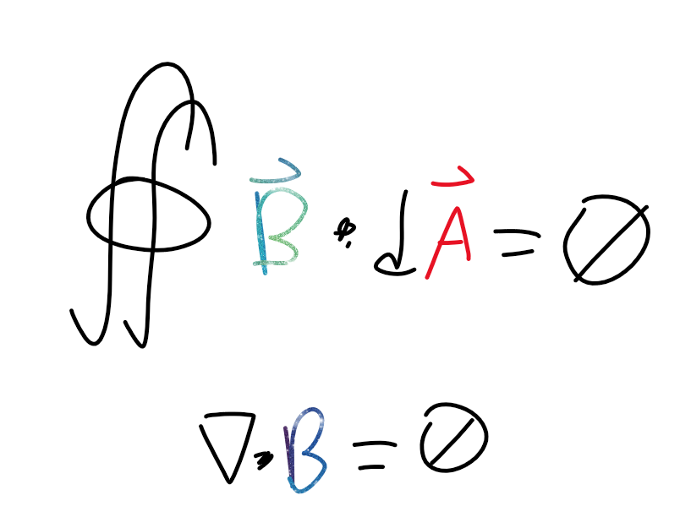
Gauss’s laws:
Electric
Magnetic

Slide 5
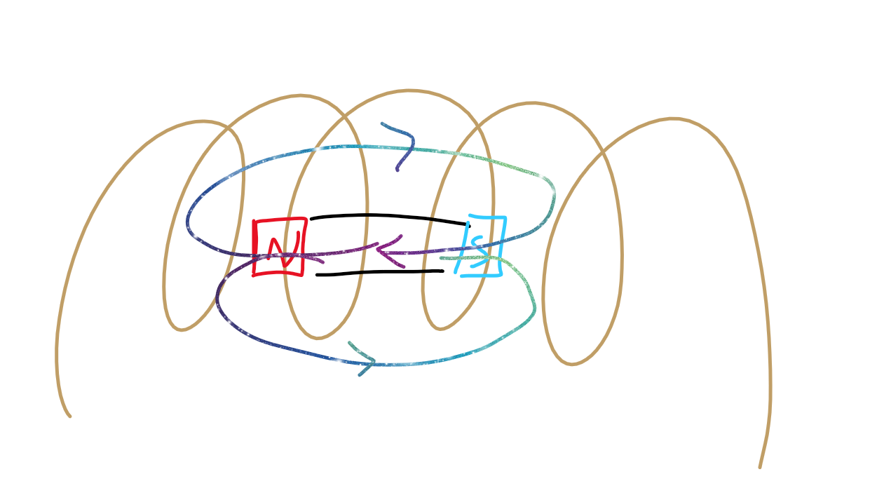
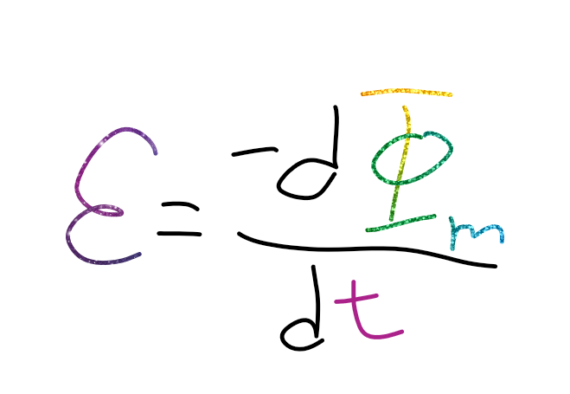
Faraday’s law
When the magnet is moving, we can have a change in magnetic flux, but as soon as motion stops, flux returns to 0.

Slide 6
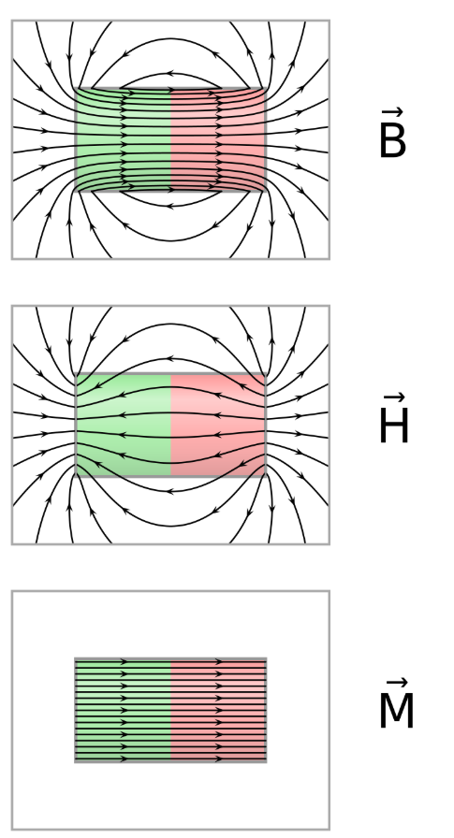
Two more fields
When magnets are close to objects that emit a magnetic field, these can induce currents within the material.
How much is caused internally?
By the external field?

Slide 7
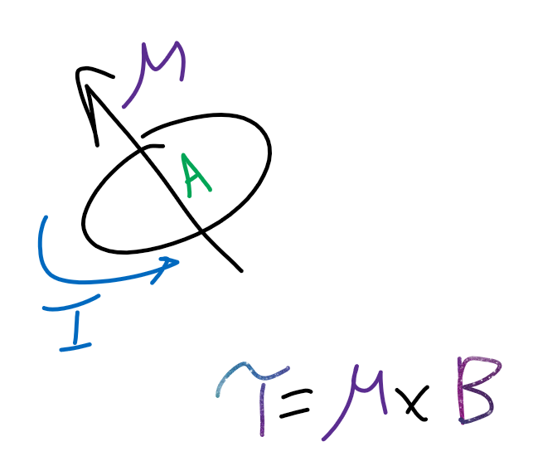
M field
Magnetization.
How much is internal.
The density of the magnetic moments in the object. (Aka, total magnetic moment divided by volume.)

Slide 8
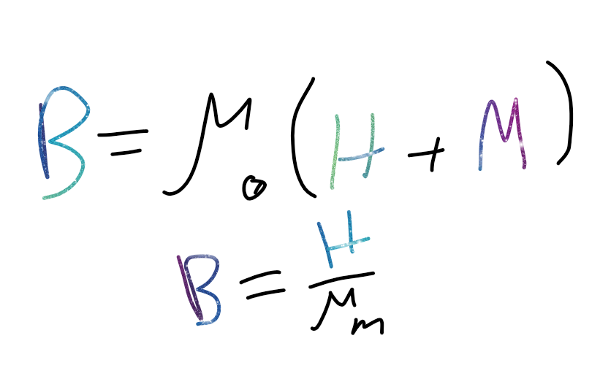
H field
Magnetic field strength.
The stuff that isn’t internal is external. . .

Slide 9
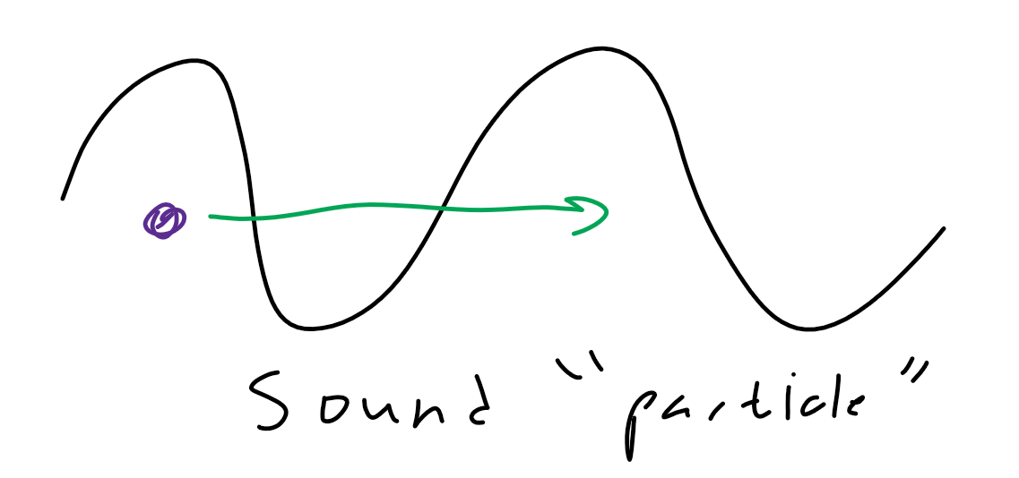
Emergent properties
Phenomena simulated as “particles.”
Phonons.

Slide 10
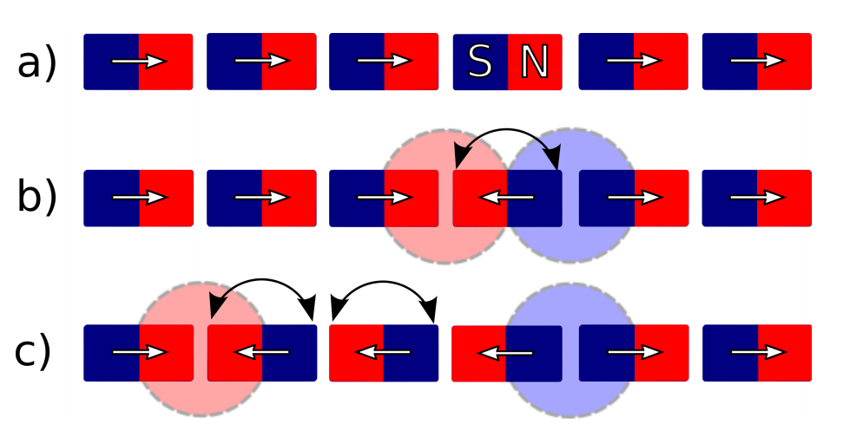
Dirac chains
There are H sinks and M sinks at the colored regions.
This causes these “isolated” regions of north and south poles.

Slide 11
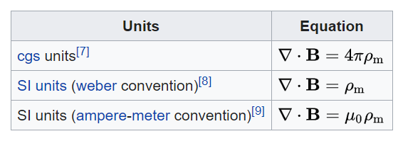
Gauss’s law?
Time to make some edits!

